Slide 1
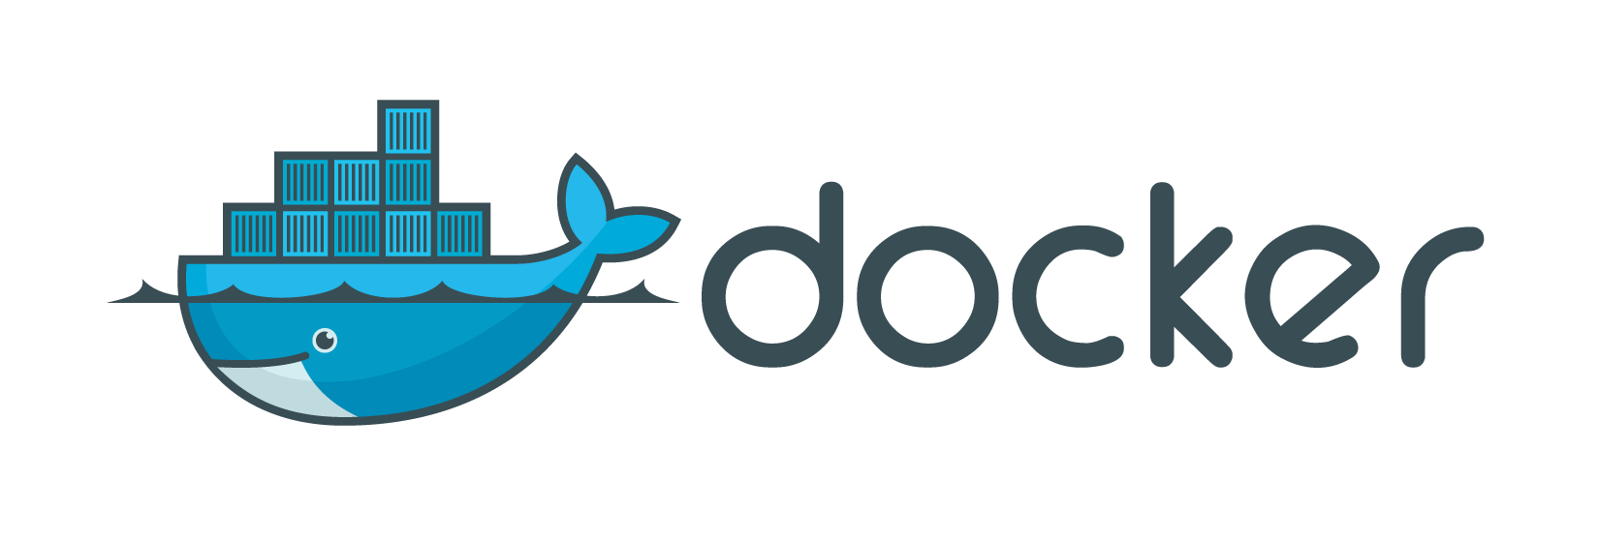
Build, ship, run

Slide 2
Docker Solution
BUILD
Compose applications without worrying about inconsistencies between environments, and locking into any platform or language.
SHIP
Design an application – development and distribution – and manage it through a consistent user interface
Docker Hub, or private Registry
RUN
Deploy scalable services on a variety of platforms

Slide 3
Why Docker?
Agility
Define environments
Create and deploy applications
Quickly respond to change
Control
Enables developers to control from infrastructure to application.
Standardize, secure, and scale the environment
Portability
Transfer or distribute applications from a personal computer, to a team, to private infrastructure, and public cloud providers

Slide 4
Docker Use Cases
CI/CD
Enable developers to develop and test applications more quickly within any environment
DevOps
Break down barriers between developers and operations teams to improve the application development process

Slide 5
GETTING Started

Slide 6
Install Docker on AWS Linux
Update your server packages
sudo yum update –y
Install Docker
sudo yum install docker –y
Start Docker service
sudo service docker start
Make Docker service start on boot up (Optional, but recommended)
sudo chkconfig docker on
Switch to root account
sudo su
Check if Docker service is running
docker ps

Slide 7
Install Docker on AWS Linux
Install Docker
sudo yum update -y && \
sudo yum install docker -y && \
sudo service docker start && \
sudo chkconfig docker on
Check if Docker is running
sudo su
docker ps

Slide 8
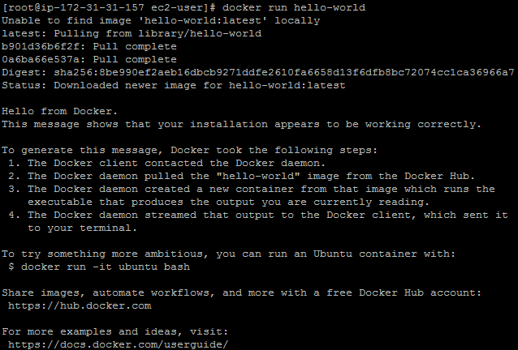
Run a simple Docker Container
Notes:
Docker daemon – persistent process that manages containers

Slide 9
Understanding images and containers

Slide 10
Docker Containers and Images
command: “docker run hello-world”
docker – tells your system to use the docker program
run – subcommand that will create and run a docker container
hello-world – tells Docker which image to load into the container
Container – a basic version of the Linux operating system.
Image – software that you load into a container.
Depending on how it was built, an image might just run a simple command and then exit. It can also be a something more complex like a database.
Notes:
The docker command did the following:
- checked to see if you had the hello-world software image
- downloaded the image from the Docker Hub (more about the hub later)
loaded the image into the container and “ran” it
Complex as a database, and can also be used to the different ADOP Tools such as Jenkins, SonarQube, Gerrit/GitLab, Sensu, ELK

Slide 11
FIND AND RUN the whalesay image

Slide 12
Find and Run the WhaleSay Image
Open your browser and go to Docker Hub (hub.docker.com)
Enter “docker / whalesay” on the search bar
Click on the docker/whalesay image on the results
Read the image information
How to use the image
How the image was built – Dockerfile
Run the docker/whalesay image
docker run docker/whalesay cowsay boo

Slide 13
WRITING YOUR OWN DOCKERFILE

Slide 14
WRITING YOUR OWN DOCKERFILE
We will try to improve the docker/whalesay image
Go to /tmp folder
cd /tmp
Create a directory
mkdir testdocker
Create a Dockerfile
touch Dockerfile
See if the Dockerfile is in the same directory
ls
Edit the Dockerfile
vim Dockerfile

Slide 15
WRITING YOUR OWN DOCKERFILE
Insert this to your Dockerfile:
FROM docker/whalesay:latest
RUN apt-get -y update && apt-get install -y fortunes
CMD /usr/games/fortune -a | cowsay
Notes:
FROM – tell which base image you are going to use
RUN – command that you will execute upon build
CMD – command that will be executed when you run the container

Slide 16
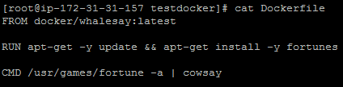
WRITING YOUR OWN DOCKERFILE

Slide 17

WRITING YOUR OWN DOCKERFILE
Check the contents of your Dockerfile
cat Dockerfile
Build your Docker Image from the Dockerfile
docker build –t docker-whale .
Check the list of your docker images
docker images

Slide 18
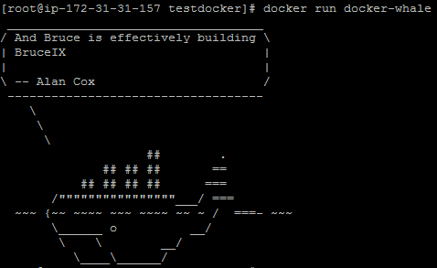
WRITING YOUR OWN DOCKERFILE
Run your new docker-whale
docker run docker-whale

Slide 19
DOCKERFILE INSTRUCTIONS

Slide 20
DOCKERFILE INSTRUCTIONS
FROM
MAINTAINER
WORKDIR
USER
ARG
ENV
ADD
RUN
EXPOSE
CMD
ENTRYPOINT

Slide 21
DOCKERFILE INSTRUCTIONS
FROM
Must be the first instruction in order to specify the Base Image from which you are building
FROM <image>:<tag>
MAINTAINER
Allows you to set the Author field of the image
MAINTAINER <name>
WORKDIR
Sets the working directory for any RUN, CMD, ENTRYPOINT, COPY, and ADD command/s that follow it in the Dockerfile.
WORKDIR </path/to/directory>
*Any succeeding WORKDIR will be relative to the previous one.

Slide 22
DOCKERFILE INSTRUCTIONS
USER
Sets the user name or UID to use when running the image and for any RUN, CMD, and ENTRYPOINT instructions that follows it.
USER <username>
ARG
Defines a variable that users can pass during a docker build using the “—build-arg <varname>=<value>” flag.
ARG <name>[=<default value>]
* If the ARG does not have a default value and was not defined by the user, it will cause an error.

Slide 23
DOCKERFILE INSTRUCTIONS
ENV
Sets an environment variable for the image.
ENV <key>=<value>
ADD
Adds new files, directories, or remote file URLs into the filesystem of the container
ADD <src> <dest>
* All the new files and directories are created with UID and GID of 0 (root user)
* <dest> is an absolute path or relative to a WORKDIR

Slide 24
DOCKERFILE INSTRUCTIONS
RUN
Executes a command in a new layer on top of the current image.
RUN <command>
EXPOSE
Makes the container listen on the specified port during runtime
EXPOSE <port>

Slide 25
DOCKERFILE INSTRUCTIONS
ENTRYPOINT
Allows you to configure a container that will run as an executable.
ENTRYPOINT [“executable”,”param1”,”param2”]
ENTRYPOINT command param1 param2
* Only the last ENTRYPOINT will have an effect.

Slide 26
DOCKERFILE INSTRUCTIONS
CMD
Provides defaults for an executing container.
CMD [“executable”,”param1”,”param2”] (exec form)
CMD [“param1”,”param2”] (as params to ENTRYPOINT)
CMD command param1 param2 (shell form)
* There can only be one CMD command instruction on a Dockerfile.
* The user can override the defaults on the CMD if they specify arguments on docker run.
* Should be used to define arguments for an ENTRYPOINT command
Notes:
Exec form does not invoke the command shell.
Example:
CMD [ "echo", "$HOME" ] will not do a substitution to $HOME
CMD [ "sh", "-c", "echo", "$HOME" ]
If you use the shell form, it will be executed in /bin/sh –c

Slide 27
DOCKERFILE SAMPLE
FROM centos
MAINTAINER <your_eid>@accenture.com
WORKDIR /tmp
ENV middlename <middle_name>
ARG lastname
ADD myname.txt .
EXPOSE 80
RUN echo $middlename >> myname.txt && \
echo $lastname >> myname.txt
CMD while true; do cat /tmp/myname.txt; sleep 10; done
Notes:
Build the docker image
docker build --build-arg lastname=<last_name> -t mycontainer/myname:1.0 .

Slide 28

DOCKERFILE SAMPLE
Build the docker image
docker build --build-arg lastname=<last_name> -t mycontainer/myname:1.0 .

Slide 29
DOCKER RUN ARGUMENTS

Slide 30
DOCKER RUN ARGUMENTS
Interactive (-i)
Tty (-t)
Detached (-d)
Remove (--rm)
Container Name (--name)
Volume (-v)
Environment variable (-e)
Port/expose (-p)
Link (--link)
Restart (--restart)

Slide 31
DOCKER RUN ARGUMENTS
docker run [OPTIONS] [IMAGE] [COMMAND] ([ARGUMENTS])
Interactive (-i)
Keep STDIN open even if not attached
TTY (-t)
Allocate a pseudo-TTY
* This will allow you to use the container like a traditional VM as long as the bash prompt is running

Slide 32
DOCKER RUN ARGUMENTS
Detach (-d)
Run container in the background and print container ID
Remove (--rm)
Automatically remove the container when it exits
Container Name (--name <name>)
Assign a name to the container
Volume (-v [src]:[destination])
Bind mount to a volume
Environment (-e <key>=<value>)
Sets run time environmental variables inside the container

Slide 33
DOCKER RUN ARGUMENTS
Port/expose (-p <port> or -p <host_port>:<container_port>)
Exposes a port or a range of ports inside the container
Can be used to bind the port to the host
Link (--link <container name or id>(:alias))
Add link to another container
Restart (--restart=always)
Sets the restart policy whether the container should or should not be restarted on exit.

Slide 34
RUN YOUR MYNAME IMAGE
Run your mycontainer/myname image
docker run -it -d --name <container_name> mycontainer/myname
See if your container is running
docker ps

Slide 35
OTHER DOCKER COMMANDS

Slide 36
OTHER DOCKER COMMANDS
Build
Run
Processes (ps)
History
Logs
Inspect
Execute (exec)
Copy (cp)
Remove (rm)
Remove Image (rmi)

Slide 37
OTHER DOCKER COMMANDS
Processes (ps)
List the containers running on the host
* You can use the “-a” command to show all the containers, even the ones that are stopped
History (history)
Shows the history of an image
Logs (logs)
Fetch the logs of a container
-f follow log output
-t show timestamps

Slide 38
OTHER DOCKER COMMANDS
Inspect (inspect)
Return low-level information on a container or image
Execute (exec)
Run a command in a running container
Copy (cp <src> <container>:<dest> or vice-versa)
Copy files/folders between a container and the local filesystem
Remove (rm <container_id>)
Removes a container
Remove Image (rmi <image_id>)
Removes an image

